Slide 1
Classifying Electrical Impedance Tomography images by resistances based on contours
Sudhanva Narayana
Machine Learning Intern
Faststream Technologies
Vinay Bansal
Chief Executive Officer
Faststream Technologies
Vinod Agrawal
Chief Technology Officer
Faststream Technologies

Slide 2
Objective
To predict disease-affected area in a patient based on Electrical Impedance Tomography Images
The following is carried out with the help of Machine Learning
Performance of various Machine Learning algorithms on these images are measured
Notes:
Impedance: the effective resistance of an electric circuit or component to alternating current, arising from the combined effects of ohmic resistance and reactance.

Slide 3
Background
Human body has different electrical properties when affected by a disease (Eg: cancer/tumour)
Surface electrodes are attached to the skin around the body part and skin impedance is measured
Impedance is measured across electrodes
Affected areas have high impedance values
Notes:
Impedance: the effective resistance of an electric circuit or component to alternating current, arising from the combined effects of ohmic resistance and reactance.

Slide 4
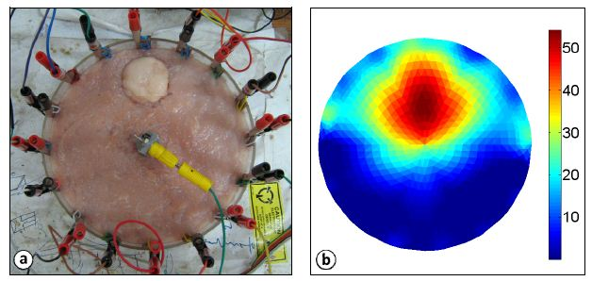
Sample Image of an EIT
Source: http://sine.ni.com/cs/app/doc/p/id/cs-14779
Notes:
The red region in the middle has high impedance value

Slide 5
Methodology
Collect data from patients and generate tomographic images
Based on the image, contours are created
Based on the area of contours, the patient is declared to have probable cause of disease
Notes:
OpenCV: Open Source Computer Vision Library

Slide 6
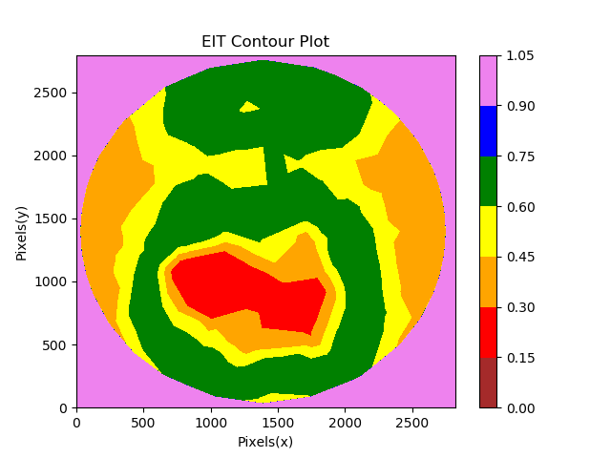
Sample Contour plot
The range of values are assigned colours only for the purpose of representation
Originally, the image is still grayscale
The red region is considered affected

Slide 7
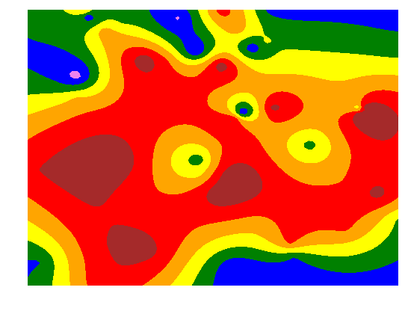
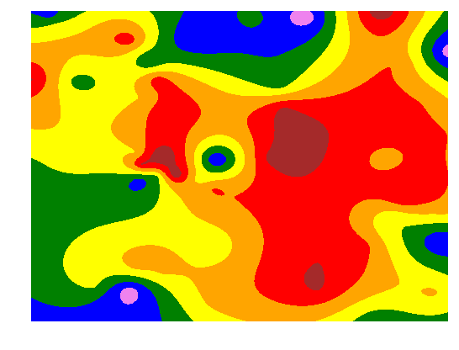
Sample Images Generated
Notes:
The red region in the middle has high impedance value

Slide 8
Implementation
As no real data is available, data is simulated
A dataset is created based on the number of pixels in the image
Mean intensity ranges are calculated and are assigned labels (colours) correspondingly
Images with higher intensities are labelled as affected images
Notes:
Linespace: Returns evenly spaced numbers over a specified interval.
Returns num evenly spaced samples, calculated over the interval [start, stop].
Meshgrid: Returns coordinate matrices from coordinate vectors.
Make N-D coordinate arrays for vectorized evaluations of N-D scalar/vector fields over N-D grids, given one-dimensional coordinate arrays x1, x2,…, xn.

Slide 9
Training the model
A dataset of 8 intensity ranges (columns) and 1000 values (rows) are created
Data is split into training set and test set
It is subjected to various machine learning algorithms like KNN, Decision Forest, Random Forest and other linear classifiers
Performance of various classification algorithms are measured
Notes:
KNN: K nearest Neighbours

Slide 10
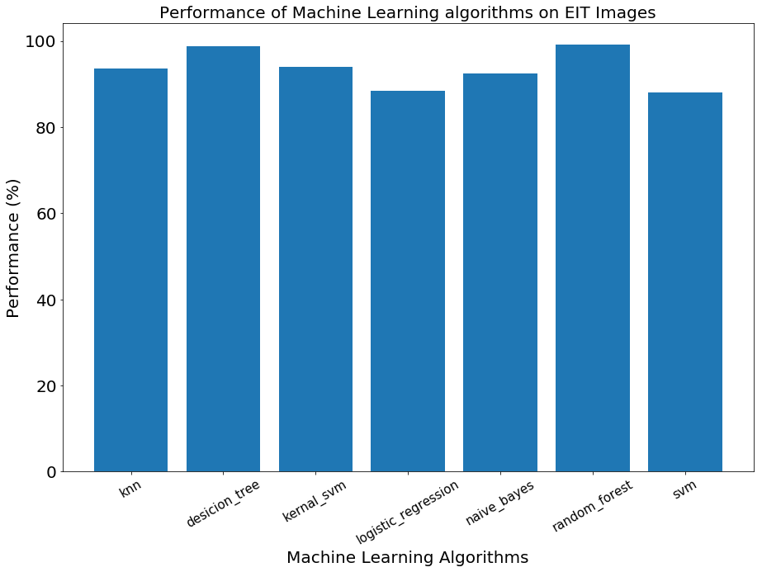
Results
No | Algorithms | Algorithms’ accuracy
1 | K Nearest Neighbours | 93.6%
2 | Decision Tree Classification | 98.8%
3 | Kernel Support Vector Machines | 94%
4 | Logistic Regression | 88.4%
5 | Naive Bayes | 92.4%
6 | Random Forest Classification | 99.2%
7 | Support Vector Machines | 88%

Slide 11
Conclusion
The performance data is collected based on the confusion matrix produced by the algorithms
Naïve Bayes, Kernel SVM and K Nearest Neighbours showcased a significant improvement compared to linear classifiers resulting at around 93%
Decision Tree and Random Forest classifiers performed better than linear classifiers and topped at almost 99%
Similar results can be expected on unseen data.
Notes:
Logistic Regression and SVM showed similar results at 88%. Naïve Bayes, Kernel SVM and K Nearest Neighbours showcased a significant improvement resulting at around 93%. However, Decision Tree and Random Forest classifiers performed better than linear classifiers. Random Forest and Decision Tree both topped at 99% making them the best algorithm to use for this kind of dataset.

